Slide 1
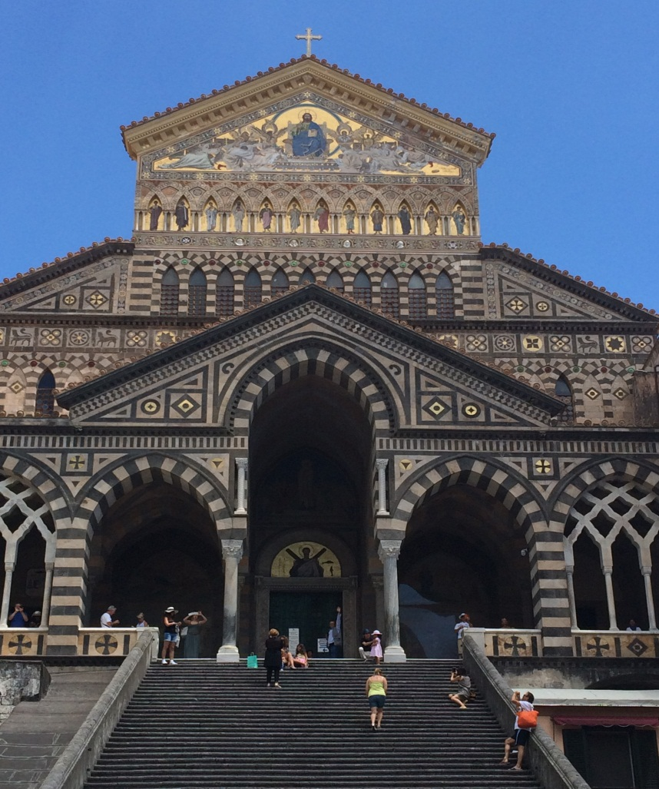
The Religious land use & institutionalized persons act

Slide 2
Types of RLUIPA Claims
Substantial Burden - 42 U.S.C. § 2000cc(a)
Equal Terms - 42 U.S.C. § 2000cc(b)(1)
Nondiscrimination - 42 U.S.C. § 2000cc(b)(2)
Exclusions and Limitations - 42 U.S.C. § 2000cc(b)(3)

Slide 3
What is Religious Exercise?
“The term ‘religious exercise’ includes any exercise of religion, whether or not compelled by, or central to, a system of religious belief.”
“The use, building, or conversion of real property for the purpose of religious exercise shall be considered to be religious exercise of the person or entity that uses or intends to use the property for that purpose.”

Slide 4
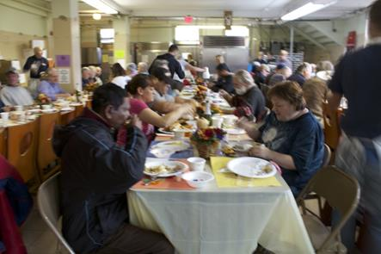
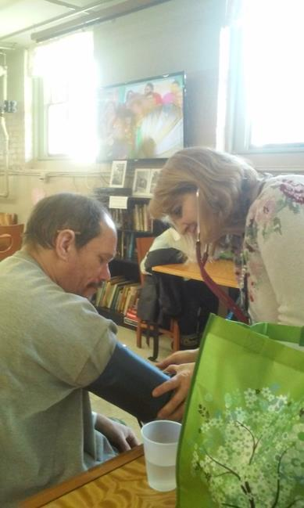
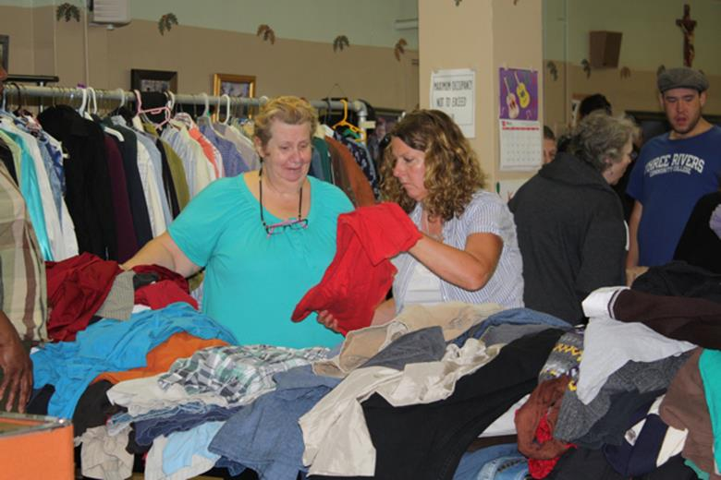
Examples of Religious Uses

Slide 5
What is NOT Religious Exercise?
If “beliefs” are not sincerely held but are instead meant to circumvent zoning regulations. Church of Universal Love & Music v. Fayette County (W.D. PA 2008)
Is mixed-use religious exercise? See Chabad Lubavitch of Litchfield County, Inc. v. Borough of Litchfield (use of the “segmented” approach)

Slide 6
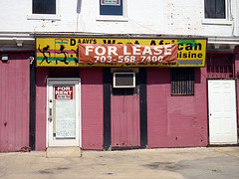
What is a “Land Use Regulation”
“[A] zoning or landmarking law, or the application of such a law, that limits or restricts a claimant’s use or development of land (including a structure affixed to land), if the claimant has an ownership, leasehold, easement, servitude, or other property interest in the regulated land or a contract or option to acquire such an interest.”
24 U.S.C. 2000-5(5)
Photo credit: Daniel Lobo

Slide 7
What is a “Land Use Regulation”?
Building & Safety Codes – No.
Salman v. City of Phoenix (D. AZ 2015).
Affordable Recovery Housing v. City of Blue Island (N.D. Ill 2016)
Environmental Review – Possibly.
Fortress Bible Church v. Feiner (2d Cir. 2012).
Eminent Domain – Maybe, but probably not.
St. John’s United Church of Christ v. City of Chicago (7th Cir. 2007); Congregation Adas Yerim v. City of New York (E.D.N.Y. 2009).

Slide 8
What is a Substantial Burden?
Congress intentionally left the term “substantial burden” undefined.
The term ‘substantial burden’ as used in this Act is not intended to be given any broader definition than the Supreme Court’s articulation of the concept of substantial burden or religious exercise. Joint Statement, 146 Cong. Rec. 16,700 (2000)

Slide 9
Where Might a Substantial Burden Claim Arise?
Complete or partial denial of application for zoning relief (special permit, rezone, site plan, etc.)
Approval of application for zoning relief subject to conditions
Order from local official (i.e., cease and desist order, notice of violation, etc.)
Text of zoning regulations

Slide 10
What is a Substantial Burden?
Is akin to significant pressure that coerces adherents to forego religious precepts or mandates religious conduct. Midrash Sephardi v. Surfside (11th Cir. 2004); Westchester Day Sch. v. Vill. of Mamaroneck (2d Cir. 2007)
Puts substantial pressure on the religious group to modify its behavior. Bethel World Outreach Ministries v. Montgomery Cnty. Council (4th Cir. 20013)
Is oppressive to a significantly great extent. San Jose Christian Coll. v. City of Morgan Hill (9th Cir.2004).
Places substantial pressure on a religious group to cause it to violate its religious beliefs or effectively bar it from using its property for religious exercise. Living Water Church of God v. Charter Twp. of Meridian (6th Cir.2007).

Slide 11
A Substantial Burden Trend?
“For many years, the Seventh Circuit described a substantial burden under RLUIPA as one that necessarily bears direct, primary, and fundamental responsibility for rendering religious exercise effectively impracticable… However, in Schlemm v. Wall … the Seventh Circuit recently revisited that standard, noting that two later decisions of the Supreme Court articulate a standard much easier to satisfy… The court explained that the relevant inquiry is whether a particular restriction seriously violated the plaintiff’s religious beliefs, including any exercise of religion, whether or not compelled by, or central to, a system of religious belief (internal quotes and citations omitted).”
Affordable Recovery Housing v. City of Blue Island (N.D. Ill 2016)

Slide 12
What Else is a Substantial Burden?
Imposing unjustified delay, uncertainty and expense on a religious group can be a substantial burden. Sts. Constantine & Helen v. New Berlin (7th Cir. 2005)
If the denial leaves the institution with no real alternatives … OR, where alternatives would impose substantial delay, uncertainty and expense, then the denial is more likely to be a substantial burden. Westchester Day School v. Mamaroneck (2d Cir. 2007)
A substantial burden may occur with the application of neutral and generally applicable regulations. Chabad Lubavitch v. Borough of Litchfield (2d Cir. 2014)

Slide 13
What is a Substantial Burden?
Even where a denial is definitive, it may not be a substantial burden if the denial will have only a minimal impact on the institution’s religious exercise.
Denial of an approval is not a substantial burden where: (a) no “reasonable” expectation of approval and (b) other sites are available. Vision Church v. Long Grove (7th Cir. 2006) & Petra Presbyterian v. Northbrook (7th Cir. 2007)

Slide 14
Substantial Burden Factors
Very Likely Yes
Nowhere to locate in the jurisdiction.
Unable to use property for religious purposes.
Imposing excessive and unjustified delay, uncertainty or expense.
Religious animus expressed by City Officials or the public, which is not renounced by officials (keep a good record)
Very Likely No
Timely denial that leaves other sites available.
Denial that has a minimal impact.
Denial where no reasonable expectation of an approval.
Personal preference, cost, inconvenience.

Slide 15
Compelling Interests
Are interests of the highest order (public health and safety)
MERE SPECULATION, not compelling; need specific evidence that religious use at issue jeopardizes the municipality’s stated interests
Need consultants’ reports, expert testimony, or evidence of harm having already occurred or certain to occur

Slide 16
Examples of Compelling Interests
Preserving the rural and rustic single family residential character of a residential zone. Eagle Cove Camp Conf. Ctr. v. Town of Woodboro (7th Cir. 2013)
Preventing crime and ensuring the safety of residential neighborhoods. Harbor Missionary Church v. City of San Buenaventura (9th Cir. 2016)
Traffic? Possibly. Westchester Day Sch. (2d Cir. 2004)

Slide 17
Least Restrictive Means
“We do not doubt that cost may be an important factor in the least restrictive means analysis … Government may need to expend additional funds to accommodate citizens’ religious beliefs.” Burwell v. Hobby Lobby, 134 S. Ct. 2751 (2014)

Slide 18
More On Least Restrictive Means
Denial of zoning application without considering any conditions or alternatives fails this test. Westchester Day Sch. (2d Cir. 2007)
“But nothing in the Court’s opinion suggests that prison officials must refute every conceivable option to satisfy RLUIPA’s least restrictive means requirement.” Holt v. Hobbs (2015) (Sotomayor, J., concurring) (emphasis added)

Slide 19
Equal Terms Provision
“No government shall impose or implement a land use regulation in a manner that treats a religious assembly or institution on less than equal terms with a nonreligious assembly or institution.”
42 U.S.C. Section 2000c-(b)(1).

Slide 20
The Equal Terms Tests
Dictionary Definition Test: Midrash Sephardi, Inc. v. Town of Surfside (11th Cir. 2004)
Regulatory Purpose Test: Lighthouse Institute for Evangelism, Inc. v. City of Long Branch (3d Cir. 2007)
Accepted Zoning Criteria Test: River of Life Kingdom Ministries v. Vill. of Hazel Crest (7th Cir. 2010)

Slide 21
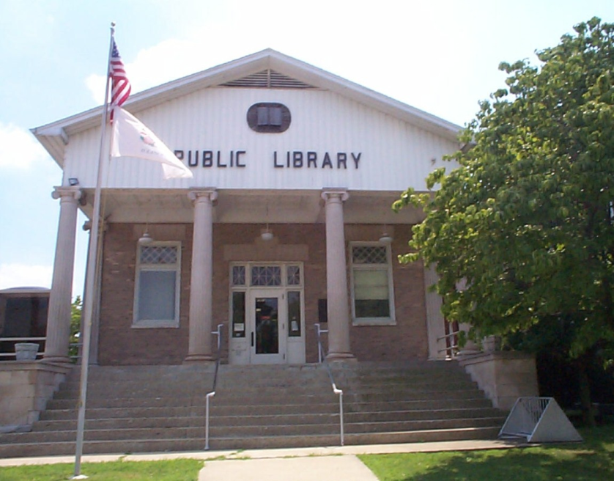
Types of Assembly Uses
Clubs
Meeting halls
Community centers
Auditoriums and theatres
Recreational facilities
Schools
Municipal uses

Slide 22
Nondiscrimination Provision
“No government shall impose or implement a land use regulation that discriminates against any assembly or institution on the basis of religion or religious denomination.”
42 U.S.C. Section 2000cc(b)(2)

Slide 23
Exclusions & Limits Provision
No government shall impose or implement a land use regulation that—
(A) totally excludes religious assemblies from a jurisdiction; or
(B) unreasonably limits religious assemblies, institutions, or structures within a jurisdiction.
42 U.S.C. Section 2000cc(b)(3)

Slide 24
RLUIPA’s “Safe Harbor” Provision
“A government may avoid the preemptive force of any provision of this chapter by changing the policy or practice that results in a substantial burden on religious exercise, by retaining the policy or practice and exempting the substantially burdened religious exercise, by providing exemptions from the policy or practice for applications that substantially burden religious exercise, or by any other means that eliminates the substantial burden.”
42 U.S.C Section 2000c-3(e)

Slide 25
Avoiding a RLUIPA Claim
Must train and educate local officials. Lack of RLUIPA training / knowledge of RLUIPA can support substantial burden claim. Grace Church of North County v. City of San Diego (S.D. Cal. 2008)

Slide 26
Avoiding a RLUIPA Claim
Be your own critic – assess your zoning code
How are assembly uses treated?
Do distinct standards apply to places of worship?
Are religious uses defined?
Are some assembly uses treated differently than religious uses (i.e., parking, height, bulk)? Regulate broadly.
Perform an inventory of religious land
Promote compelling interests
PLAN FOR RELIGIOUS USES

Slide 27
Avoiding a RLUIPA claim
When an application under your zoning code is filed by a religious organization, perform a RLUIPA analysis
Determine from the applicant the reasons for the application (i.e. identify applicant’s needs and determine how limitations on use may cause burden)
Compare the nature and extent of the application to that of other applicants that could be regarded as comparators
Determine the risk of an equal terms claim if application is denied in whole or in part

Slide 28
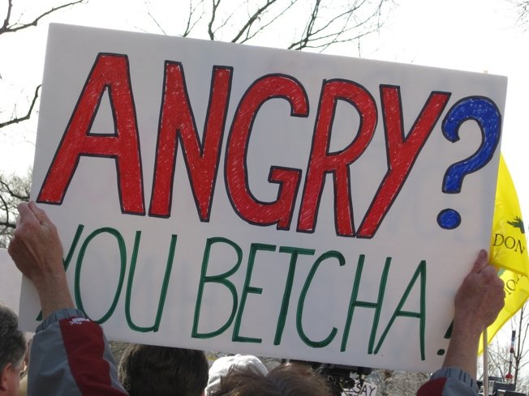
Avoiding a RLUIPA Claim
Avoid discriminatory comments by agency members and the public. See Fortress Bible Church v. Feiner (2d Cir. 2012); Al Falah Center v. Township of Bridgewater (D. NJ 2013)
Cleanse the record

Slide 29
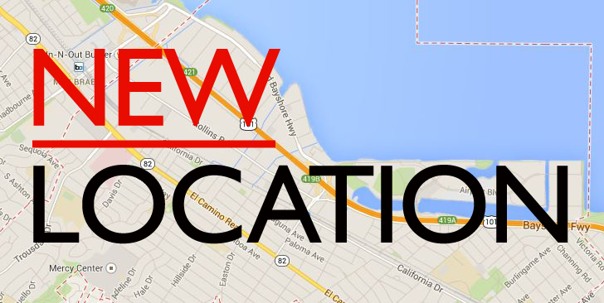
Avoiding a RLUIPA Claim
Invite the applicant to propose a less intensive use (can municipal goals be met in a less restrictive manner?)
Negotiate reasonable conditions
Negotiate a

Slide 30
Thank You! Evan J. Seeman, Esq. eseeman@rc.com www.rluipa-defense.com

