Slide 1
RLUIPA Defense: Avoiding and Defending RLUIPA Claims
Annual Land-Use Law Webinar Teleconference Series

Slide 2
Happy to Be Here
Evan Seeman
(Hartford office)
Karla Chaffee
(Boston office)
RLUIPA Group Members at
Blog authors at www.RLUIPA-Defense.com

Slide 3
Congress enacts RLUIPA in 2000

Slide 4
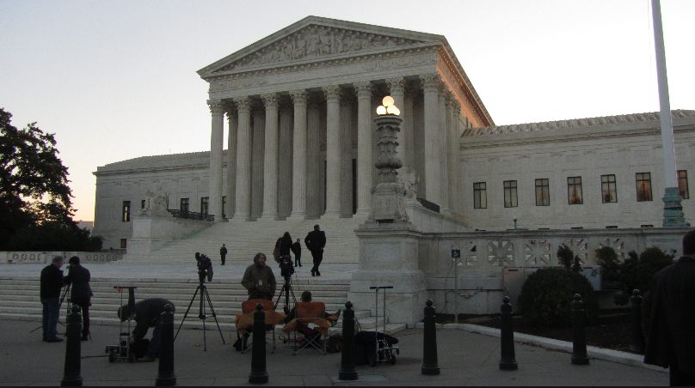
History & Intent
Sherbert v. Verner, 374 U.S. 398 (1963)
Employment Div. v. Smith, 494 U.S. 872 (1990)
Church of Lukumi Babalu Aye v. City of Hialeah, 508 U.S. 520 (1993)
Religious Freedom Restoration Act of 1993
City of Boerne v. Flores, 521 U.S. 507 (1997)

Slide 5
RLUIPA
The Basics:
Substantial Burden
42 U.S.C. § 2000cc(a)
Equal Terms
42 U.S.C. § 2000cc(b)(1)
Nondiscrimination
42 U.S.C. § 2000cc(b)(2)
Exclusions and Limitations
42 U.S.C. § 2000cc(b)(3)

Slide 6
What are the most common claims and most contested RLUIPA issues?
Substantial Burden
Compelling Governmental Interest
Least Restrictive Means
Equal Terms - Comparators

Slide 7
Substantial Burden In The Circuits

Slide 8
Substantial Burden In the Circuits

Slide 9
What constitutes a “substantial burden” on religious exercise?
Very Likely Yes
Nowhere to locate in the jurisdiction.
Unable to use property for religious purposes.
Imposing excessive and unjustified delay, uncertainty or expense.
Religious animus expressed by City Officials.
Very Likely No
Timely denial that leaves other sites available.
Denial that has a minimum impact.
Denial where no reasonable expectation of an approval.
Personal preference, cost, inconvenience.

Slide 10
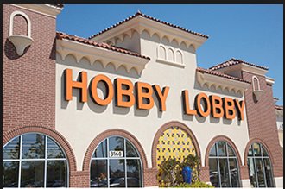
Impact of Hobby Lobby And Holt v. Hobbs?
Both Holt and Hobby Lobby may impact how courts evaluate whether a governmental interest is “compelling” and furthered by “the least restrictive means” available.

Slide 11
Impact of Hobby Lobby And Holt v. Hobbs?
The Seventh Circuit has concluded that Holt and Hobby Lobby articulated a substantial burden standard “much easier to satisfy” than that previously used in the circuit.
Is C.L.U.B. v. City of Chicago, No. 01-4030 (7th Cir. 2003) still good law?

Slide 12
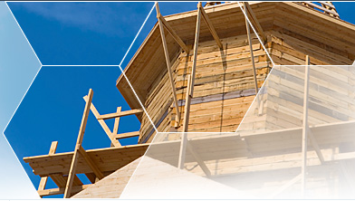
Compelling Interests
MERE SPECULATION, not compelling; need specific evidence that religious use at issue jeopardizes the municipality’s stated interests
Compelling interests are interests of the highest order (public health and safety)

Slide 13
Examples of Compelling Interests
Preservation of a municipality’s rural and rustic single family residential character of a residential zone. Eagle Cove Camp Conf. Ctr. v. Town of Woodboro, 734 F.3d 673 (7th Cir. 2013)
Ensuring the safety of residential neighborhoods through zoning. Westchester Day School v. Mamaroneck, 417 F.Supp. 2d 477, 551 (S.D.N.Y. 2006), 504 F.3d 338 (2d Cir. 2007)
Traffic? Possibly. Westchester Day Sch. v. Vill. of Mamaroneck (2d Cir. 2004)
Not compelling? Property values, revenue generation.

Slide 14
Least Restrictive Means
“We do not doubt that cost may be an important factor in the least restrictive means analysis … Government may need to expend additional funds to accommodate citizens’ religious beliefs.” Burwell v. Hobby Lobby, 134 S. Ct. 2751 (2014)
“‘The least-restrictive-means standard is exceptionally demanding,’ and it requires the government to ‘sho[w] that it lacks other means of achieving its desired goal without imposing a substantial burden on the exercise of religion by the objecting part[y].’” Holt v. Hobbs, 135 S.Ct. 853 (2015)(quoting Hobby Lobby)

Slide 15
More On Least Restrictive Means
Denial of zoning application without consideration of any conditions or alternatives fails this test. Westchester Day Sch. (2d Cir. 2007)
“But nothing in the Court’s opinion suggests that prison officials must refute every conceivable option to satisfy RLUIPA’s least restrictive means requirement.” Holt v. Hobbs (2015) (Sotomayor, J., concurring) (emphasis added)
Must strike “delicate balance” between religious practice and governmental interest. Jova v. Smith, 582 F.3d 410, 416 (2d Cir. 2009)

Slide 16
Equal Terms: More Circuit Variability
a church and school were insufficiently comparable, given that the properties sought different forms of zoning relief from different land use authorities applying "sharply different" criteria. (11th Cir., Primera Iglesia )
secular assemblies that are similarly situated as to the regulatory purpose. (3rd Cir., Lighthouse)
secular comparator, similarly situated with respect to an accepted zoning criteria (7th Cir., River of Life Kingdom)
(1) the regulatory purpose or zoning criterion behind the regulation, as stated explicitly in the text of the ordinance or regulation; and (2) whether the religious assembly or institution is treated as well as every other nonreligious assembly or institution that is "similarly situated" with respect to the stated purpose or criterion. (5th Cir., Opulent Life Church)

Slide 17
Individual Liability
RLUIPA creates an express private cause of action allowing relief against a government. 42 U.S.C. § 2000cc-2(a).
In Sossamon v. Texas, the Supreme Court held that sovereign immunity forecloses the availability of money damages as a remedy against states and state actors in their official capacities under RLUIPA. 131 S. Ct. 1651, 1663 (2011)(A Prisoner Case).
Does this holding extend to land uses cases?
A resounding yes from the Sixth Circuit

Slide 18
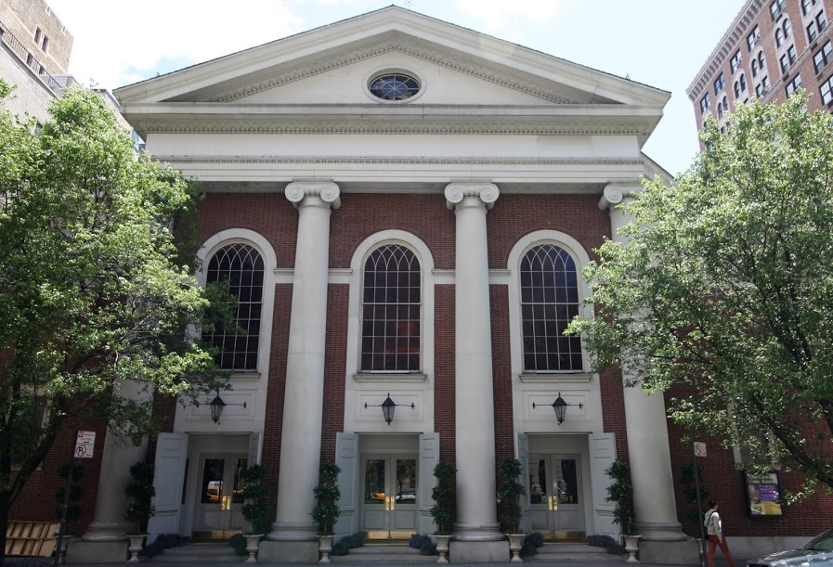
Avoiding a RLUIPA Claim
Assess your zoning code
How are all assembly uses treated?
Do distinct standards apply to places of worship?
What other RLUIPA provisions are commonly a part of facial claims?

Slide 19
Avoiding a RLUIPA claim
When an application under your zoning code is filed by a religious organization, perform a RLUIPA analysis
Determine from the applicant the reasons for the application (i.e. what burdens on religion now exist)
Attempt to identify and measure the burden that might be imposed if the application is denied in whole or in part
Compare the nature and extent of the application to that of other applicants that could be regarded as comparators
Attempt to determine the risk of an equal terms claim if application is denied in whole or in part

Slide 20
Avoiding a RLUIPA Claim
Invite the applicant to propose a less intensive use (can municipal goals be met in a less restrictive manner?)
Negotiate a new location
Plan for religious use
Educate local officials
RLUIPA’s Safe Harbor provision
Insure that RLUIPA claims are covered under your governmental liability policy

Slide 21
Defending a RLUIPA Claim
Invariably Expensive
Time and Money – lawyers, coincident environmental proceedings, experts (land use, damages, environmental)
Probably document intensive
Equal terms, free exercise, facial, and as-applied challenges usually involve extensive documentation
Document Intensive
Cases are fact intensive

Slide 22
Defending a RLUIPA Claim
Once brought, rarely settled
Legal fees
Cases become matters of faith to plaintiffs
Difficult to defend at trial
Most are claimed to a jury
God vs. Government bias potential
Cross-examination of church officials requires tact not ferocity
Jury instructions invariably confusing
Federal judiciary rarely has RLUIPA or land use experience

Slide 23
Thanks for having us!
Questions, Comments & War Stories?
Karla L. Chaffee: 617.557.5956 | kchaffee@rc.com
Evan J. Seeman: 860.275.8247 | eseeman@rc.com

